Slide 1
Parabolas, Circles, Spheres

Slide 2
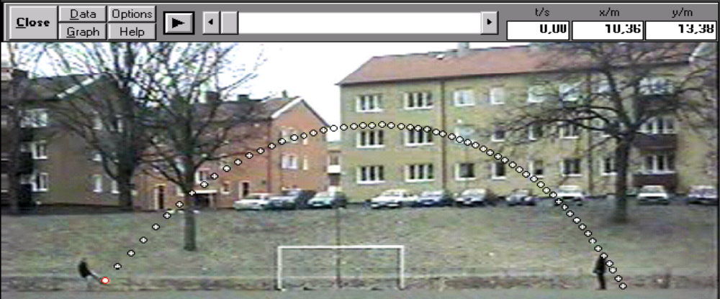
Parabolic Equations
Models projectile motion or used to create curved paths.
Types of parabolas:
  A parabola with a vertical axis
  A parabola with a horizontal axis

Slide 3
Parabolic Equations
Vertical Axis Symmetry:
General Form: y = ax² + bx + c
Vertex Form: y = a(x-h)² + k vertex point (h,k)
(a,b,c,h and k are constants; a ≠ 0)
Horizontal Axis Symmetry:
General Form: x = ay² + by + c
Vertex Form: x = a(y-k)² + h vertex point (h,k)
‘a’ determines direction and width of parabola opening
Direction
  Positive ‘a’, opens up or right
  Negative ‘a’, opens down or left
  Width
  Closer ‘a’ is to zero, wider parabola
  Farther ‘a’ is from zero (positive or negative), narrower parabola

Slide 4
Circle
For a circle with radius, r, and center point (h,k)
r² = (x-h)² + (y-k)²

Slide 5
Sphere
For a sphere with radius, r, and center point (h,k,l)
r² = (x-h)² + (y-k)² + (z-l)²

Slide 6
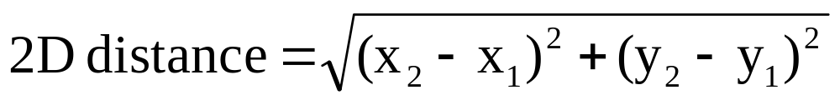
Distance Formulas

Slide 7
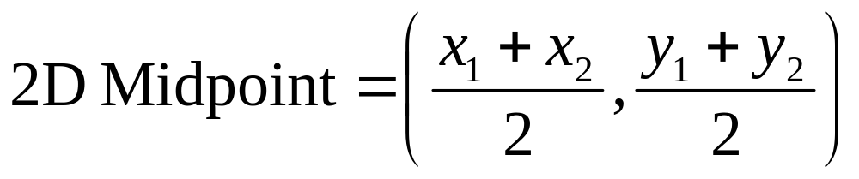
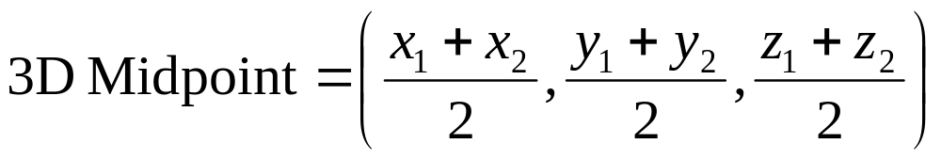
Midpoint formula
Midpoint (x,y,z) : Average distance between each coordinate of the original two points.

